Slide 1


Prostate MRI Contouring Atlas
Prostate Case 1
Please cite: Song et al. IJROBP 2025. PMID: 40154847
SeibertLab.com

Slide 2
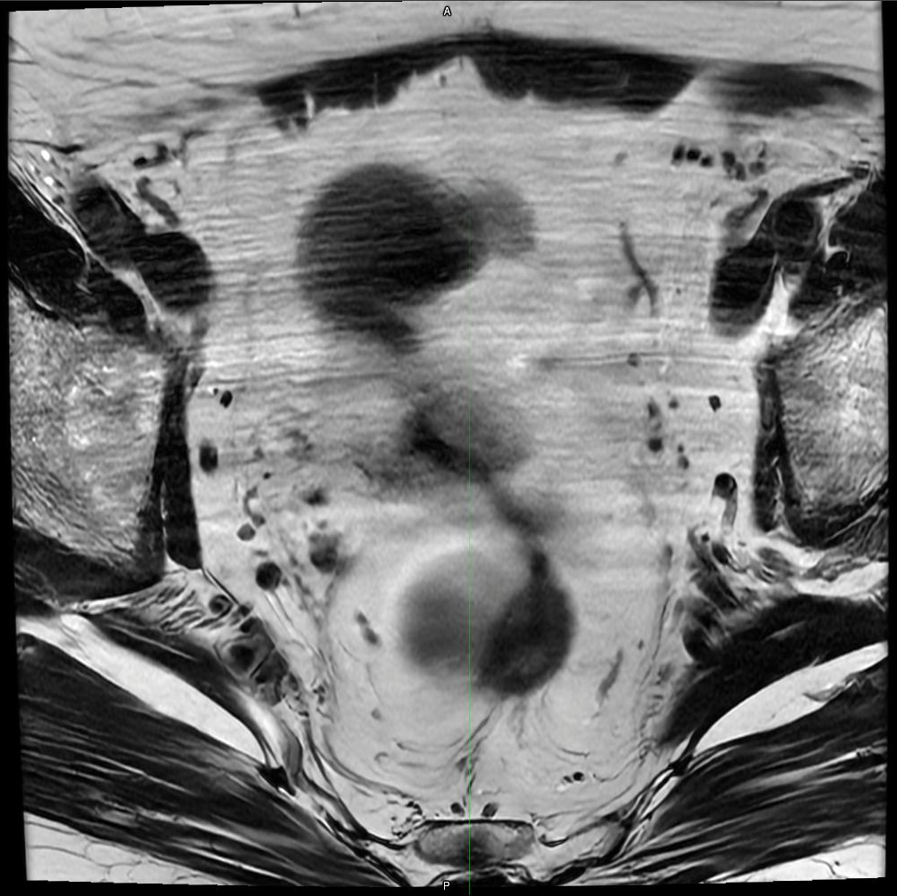
Prostate MRI Contouring Atlas – Prostate Case 1
Axial Slice 1
Song, et al. IJROBP 2025. PMID: 40154847
SeibertLab.com

Slide 3
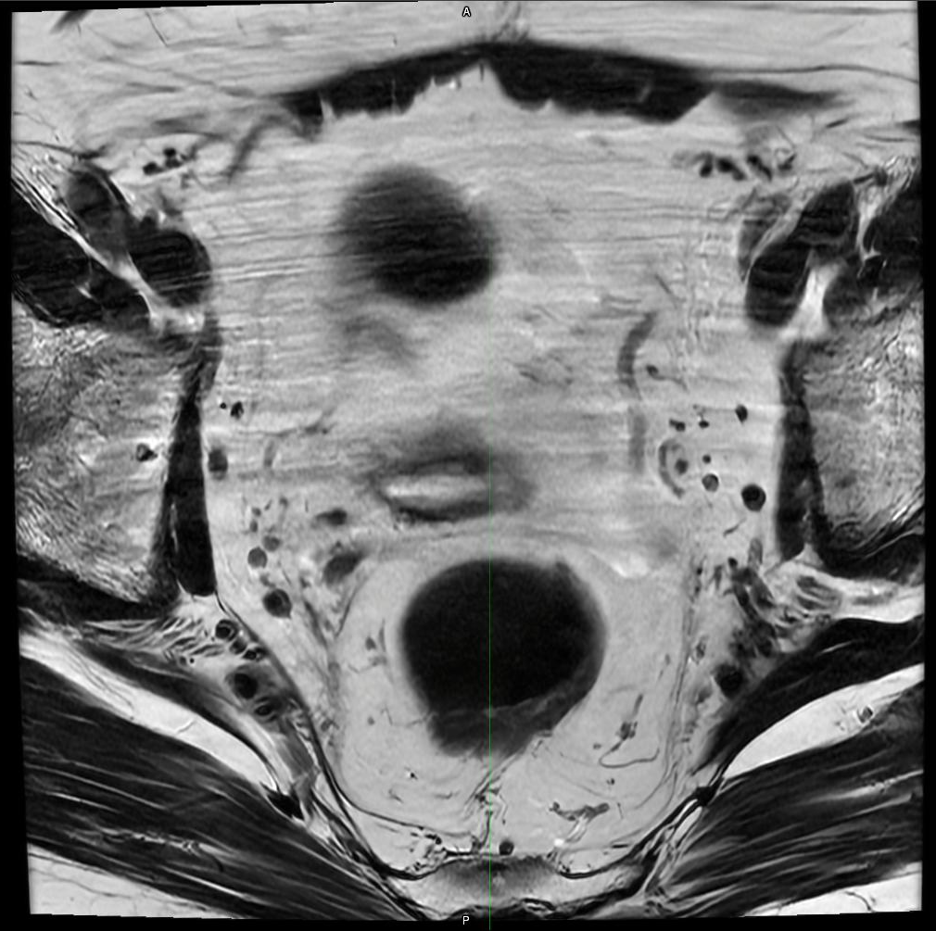
Prostate MRI Contouring Atlas – Prostate Case 1
Axial Slice 2
Song, et al. IJROBP 2025. PMID: 40154847
SeibertLab.com

Slide 4
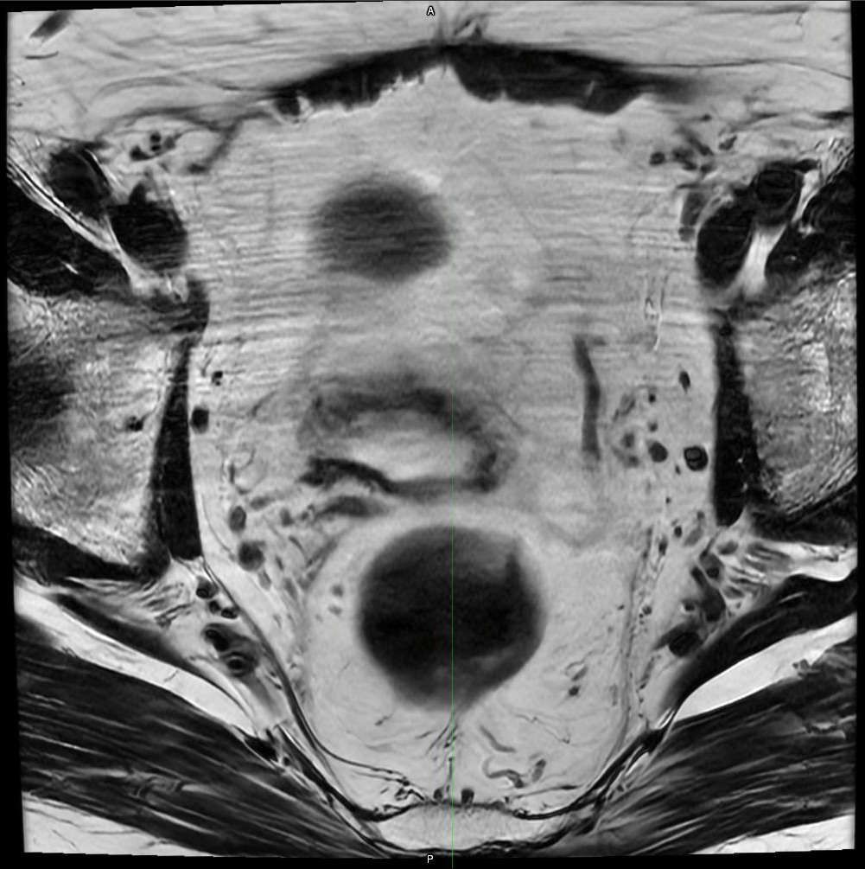
Prostate MRI Contouring Atlas – Prostate Case 1
Axial Slice 3
Song, et al. IJROBP 2025. PMID: 40154847
SeibertLab.com

Slide 5
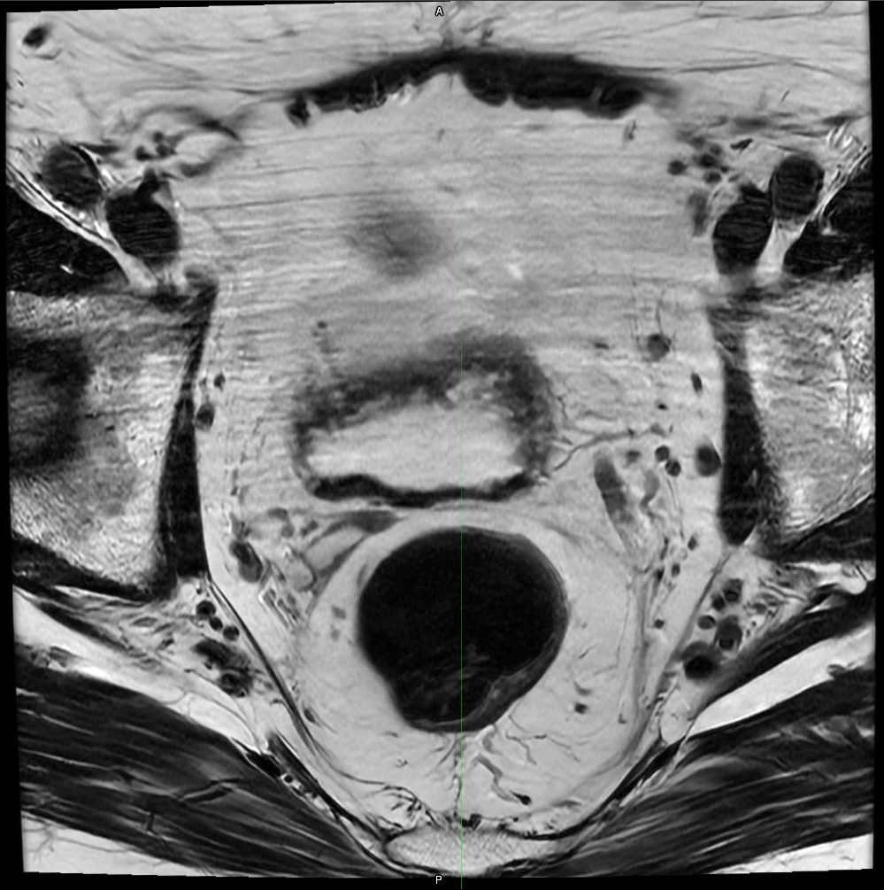
Prostate MRI Contouring Atlas – Prostate Case 1
Axial Slice 4
Song, et al. IJROBP 2025. PMID: 40154847
SeibertLab.com

Slide 6
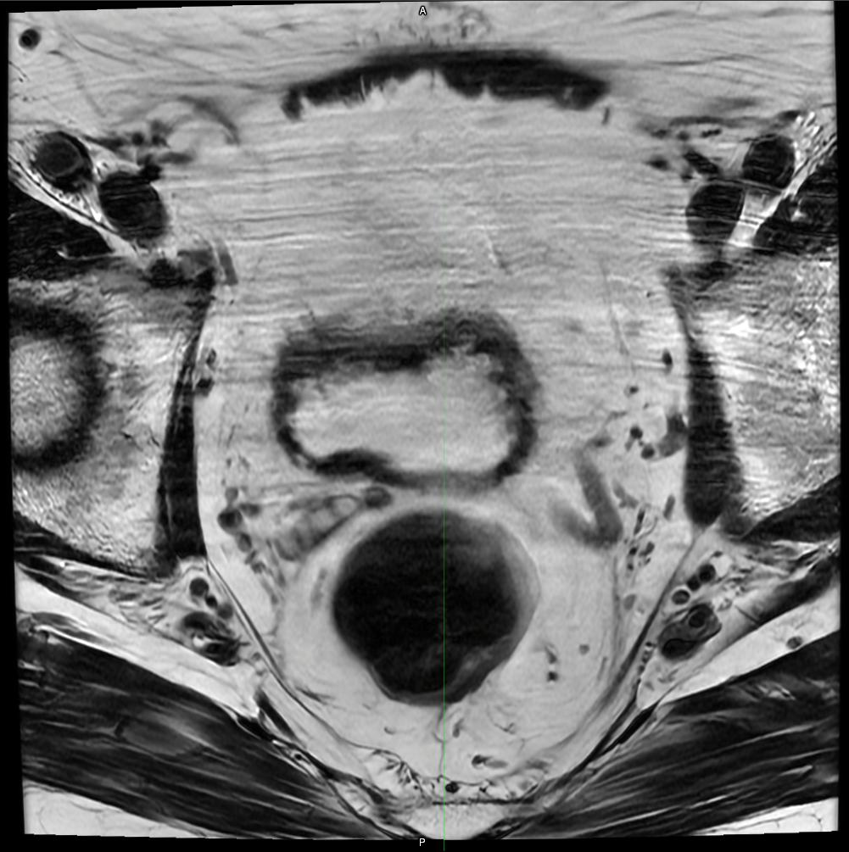
Prostate MRI Contouring Atlas – Prostate Case 1
Axial Slice 5
Song, et al. IJROBP 2025. PMID: 40154847
SeibertLab.com

Slide 7
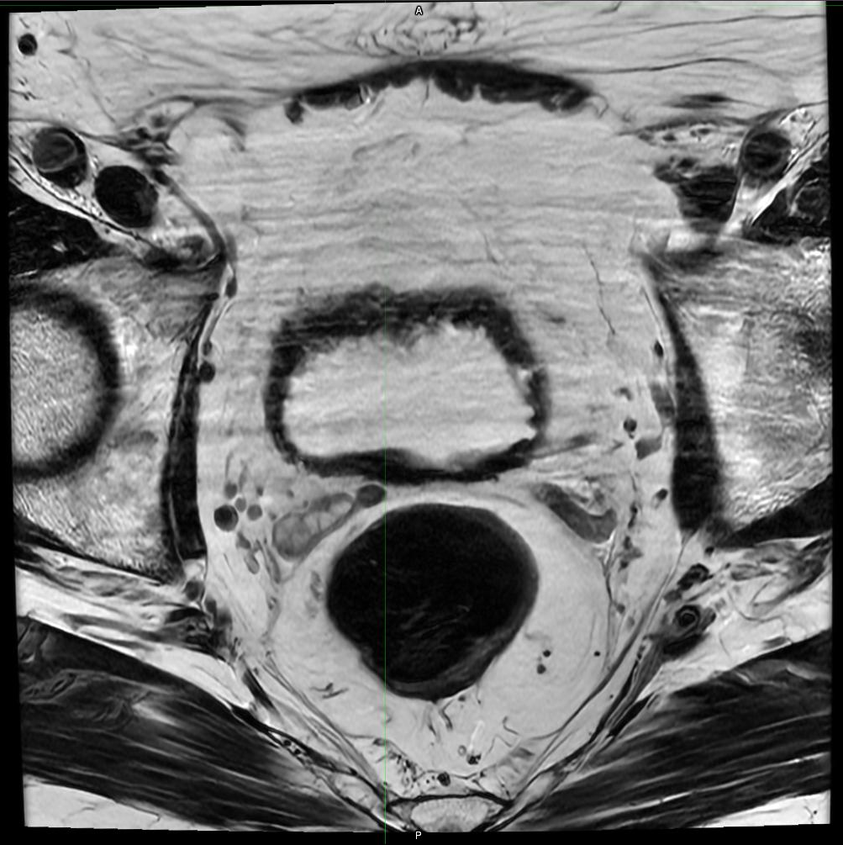
Prostate MRI Contouring Atlas – Prostate Case 1
Axial Slice 6
Song, et al. IJROBP 2025. PMID: 40154847
SeibertLab.com

Slide 8
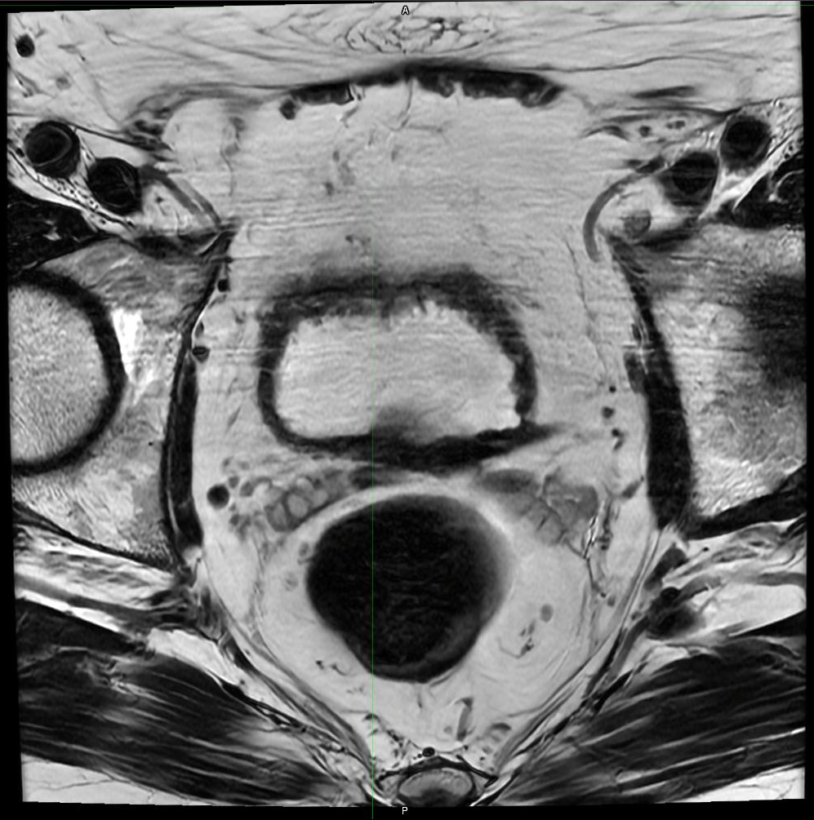
Prostate MRI Contouring Atlas – Prostate Case 1
Axial Slice 7
Song, et al. IJROBP 2025. PMID: 40154847
SeibertLab.com

Slide 9
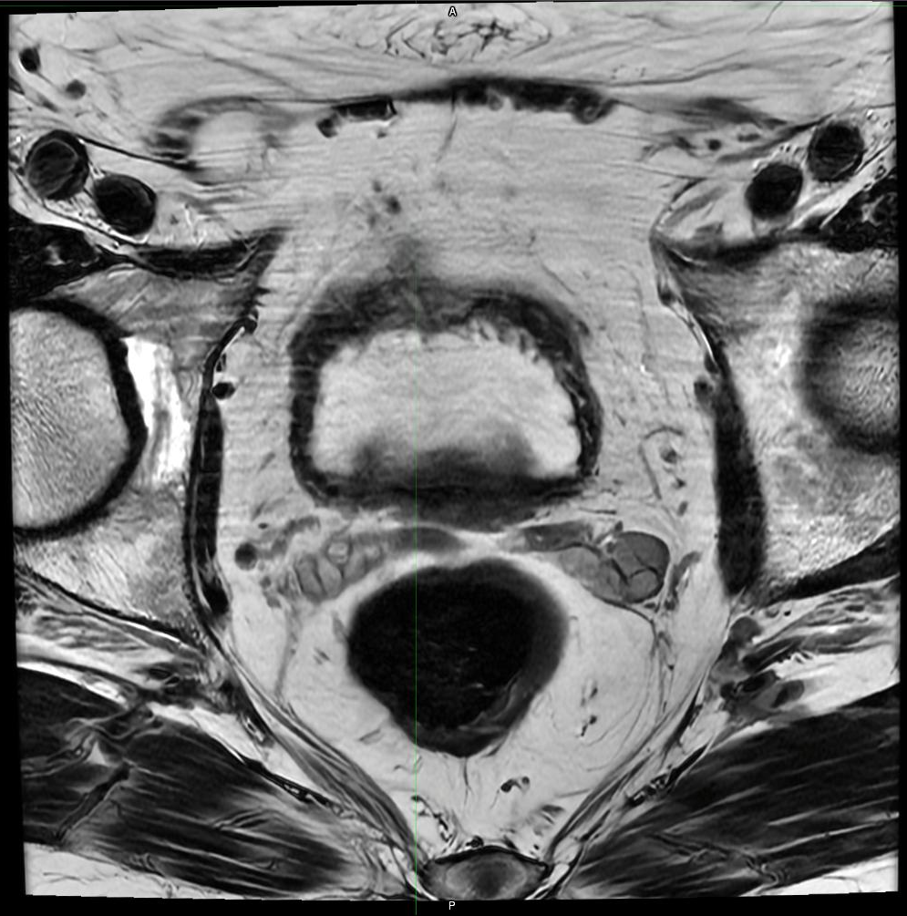
Prostate MRI Contouring Atlas – Prostate Case 1
Axial Slice 8
Song, et al. IJROBP 2025. PMID: 40154847
SeibertLab.com

Slide 10
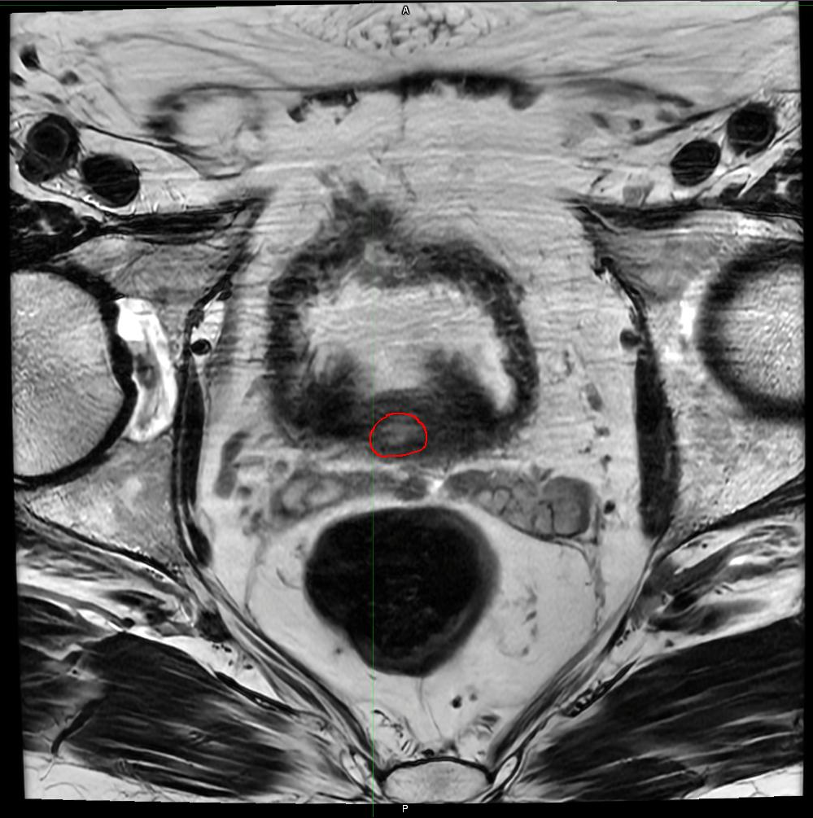
Prostate MRI Contouring Atlas – Prostate Case 1
Axial Slice 9
Song, et al. IJROBP 2025. PMID: 40154847
SeibertLab.com

Slide 11
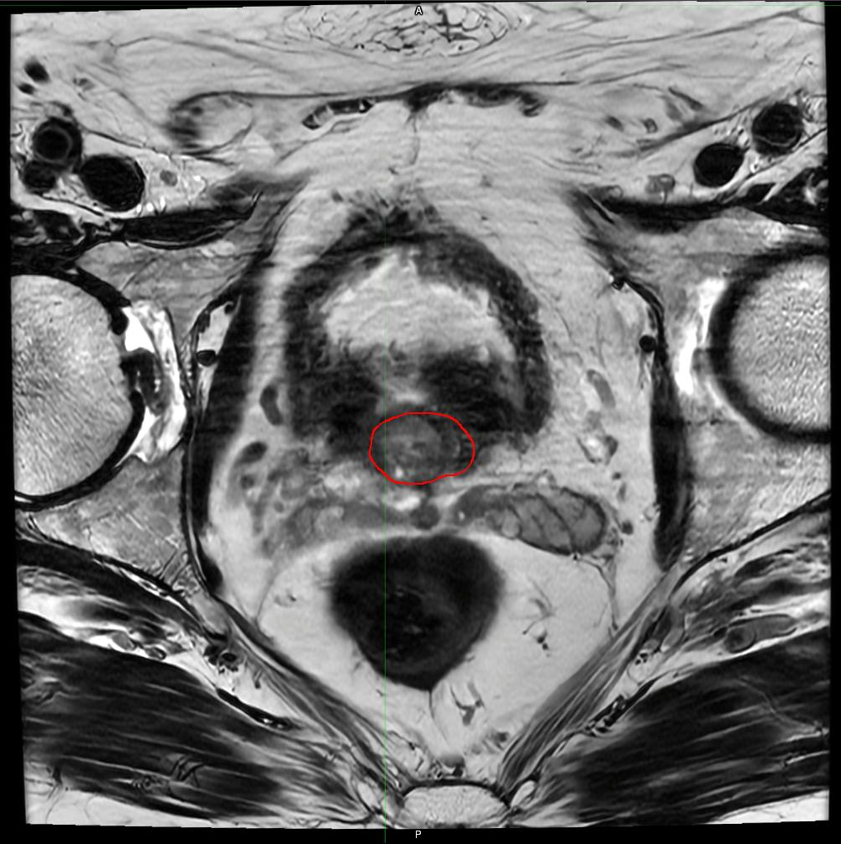
Prostate MRI Contouring Atlas – Prostate Case 1
Axial Slice 10
Song, et al. IJROBP 2025. PMID: 40154847
SeibertLab.com

Slide 12
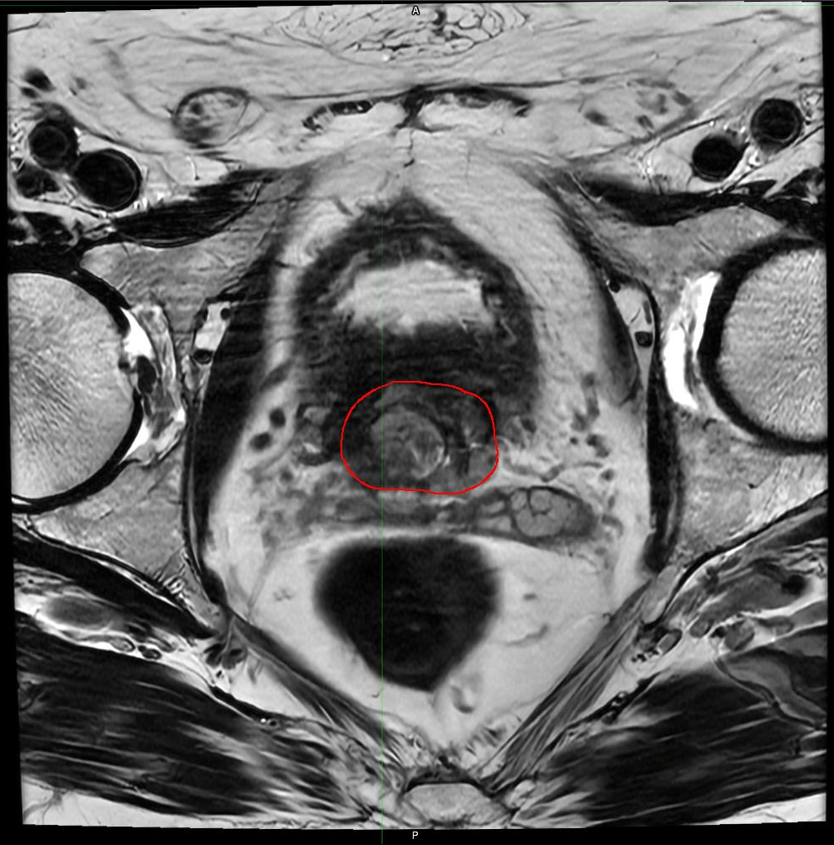
Prostate MRI Contouring Atlas – Prostate Case 1
Axial Slice 11
Song, et al. IJROBP 2025. PMID: 40154847
SeibertLab.com

Slide 13
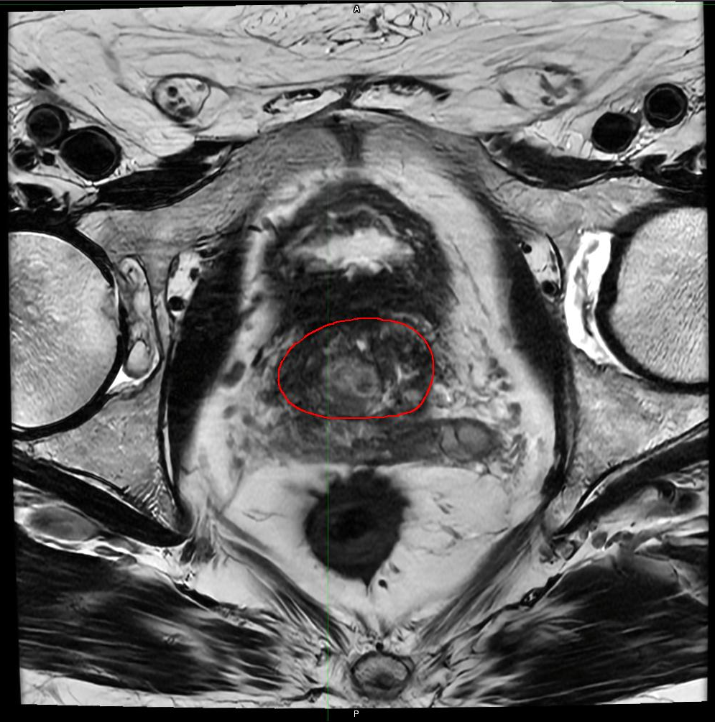
Prostate MRI Contouring Atlas – Prostate Case 1
Axial Slice 12
Song, et al. IJROBP 2025. PMID: 40154847
SeibertLab.com

Slide 14
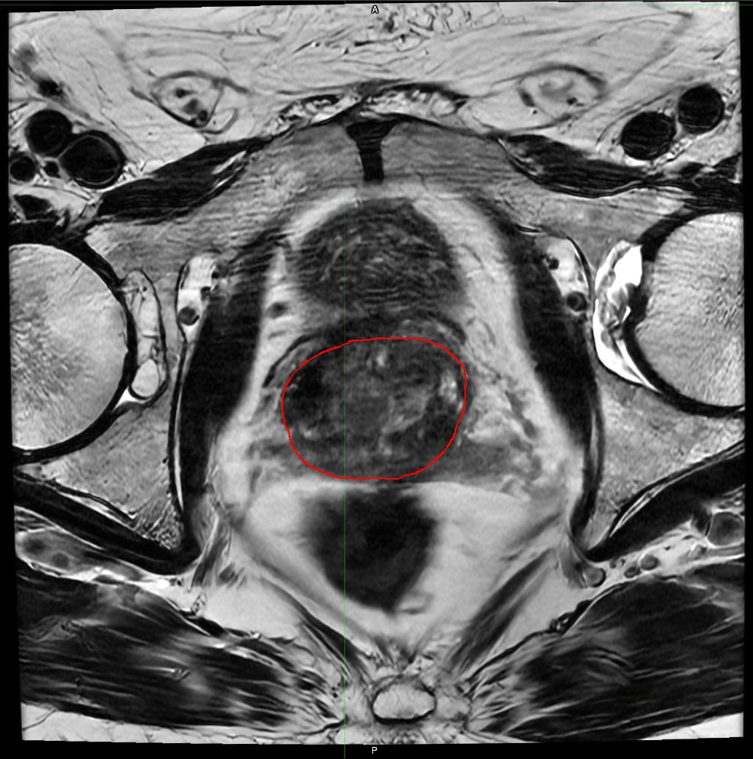
Prostate MRI Contouring Atlas – Prostate Case 1
Axial Slice 13
Song, et al. IJROBP 2025. PMID: 40154847
SeibertLab.com

Slide 15
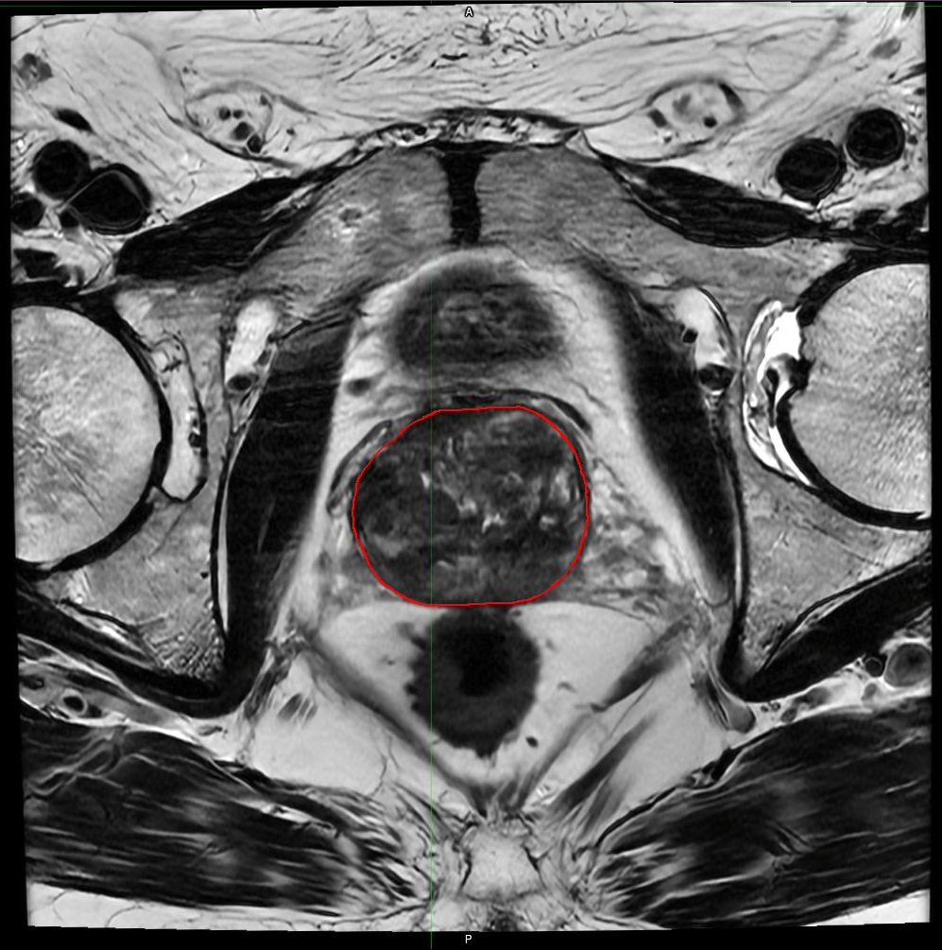
Prostate MRI Contouring Atlas – Prostate Case 1
Axial Slice 14
Song, et al. IJROBP 2025. PMID: 40154847
SeibertLab.com

Slide 16
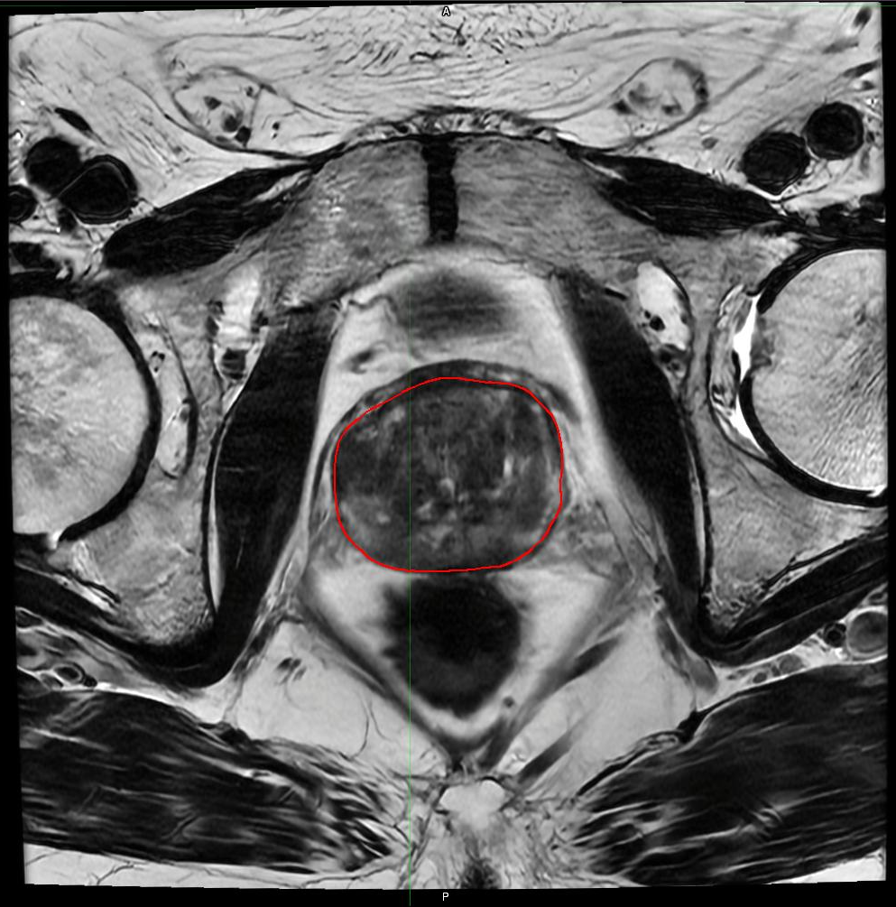
Prostate MRI Contouring Atlas – Prostate Case 1
Axial Slice 15
Song, et al. IJROBP 2025. PMID: 40154847
SeibertLab.com

Slide 17
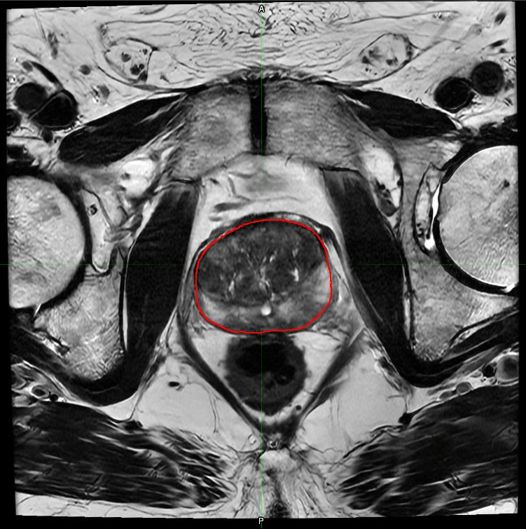
Prostate MRI Contouring Atlas – Prostate Case 1
Axial Slice 16
Song, et al. IJROBP 2025. PMID: 40154847
SeibertLab.com

Slide 18
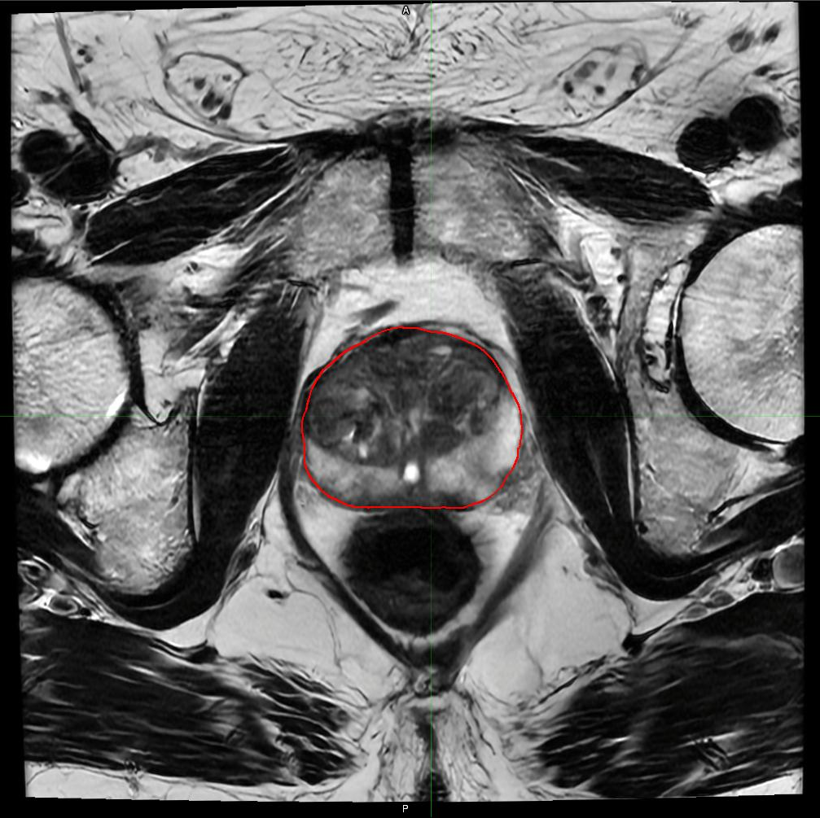
Prostate MRI Contouring Atlas – Prostate Case 1
Axial Slice 17
Song, et al. IJROBP 2025. PMID: 40154847
SeibertLab.com

Slide 19
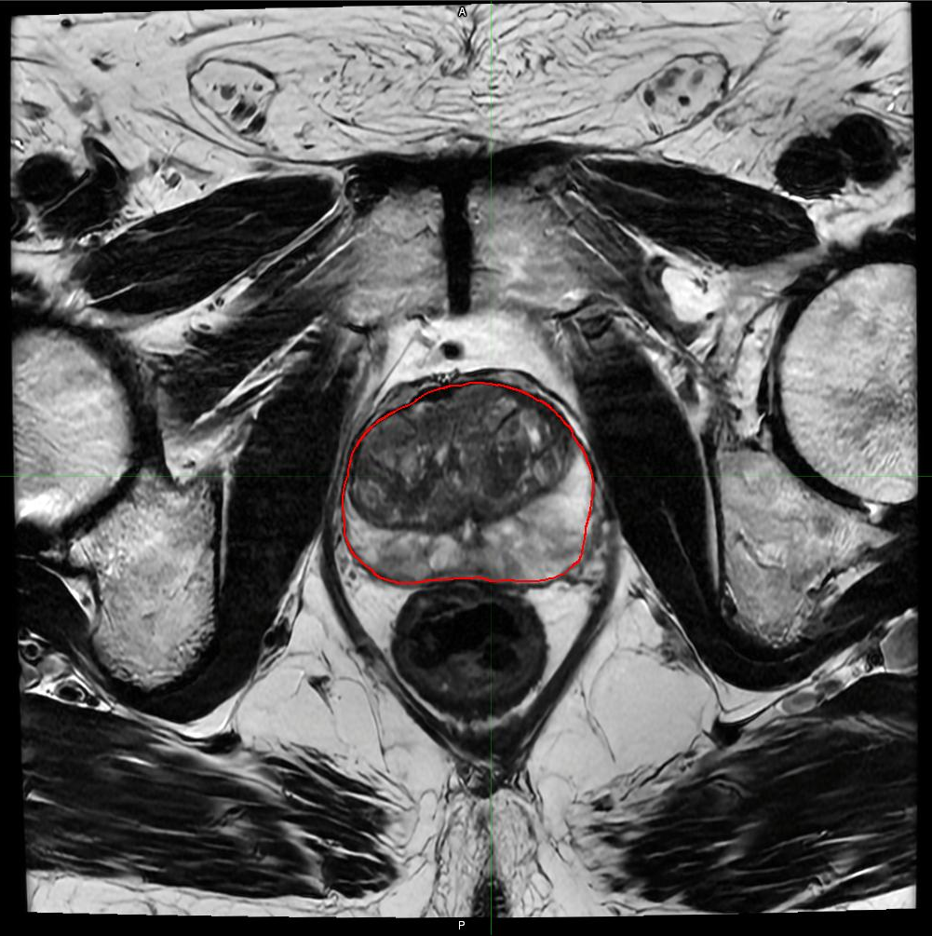
Prostate MRI Contouring Atlas – Prostate Case 1
Axial Slice 18
Song, et al. IJROBP 2025. PMID: 40154847
SeibertLab.com

Slide 20
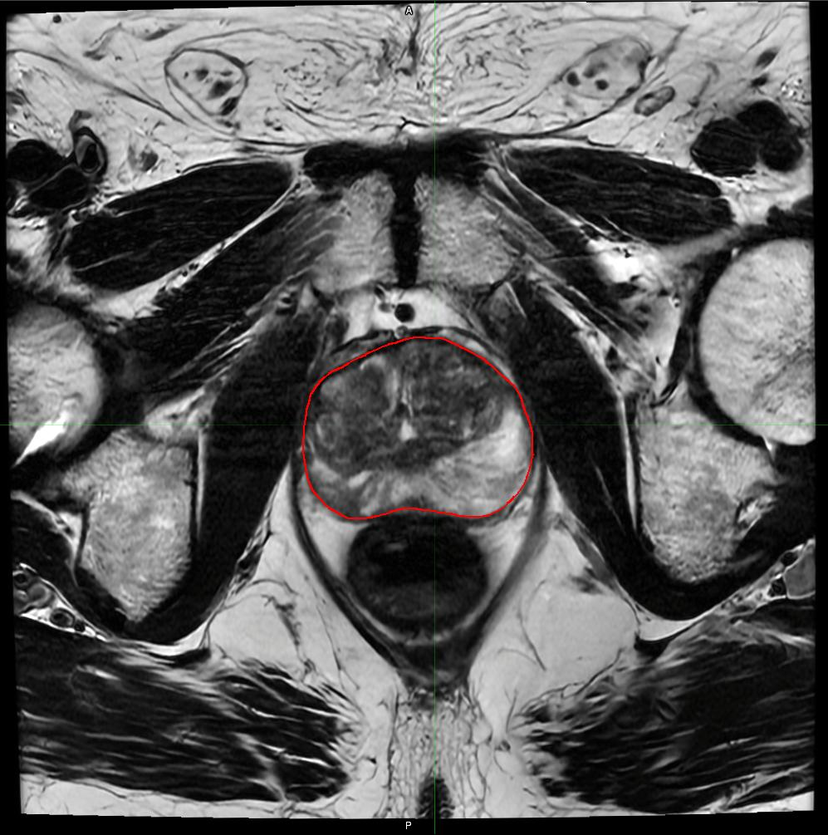
Prostate MRI Contouring Atlas – Prostate Case 1
Axial Slice 19
Song, et al. IJROBP 2025. PMID: 40154847
SeibertLab.com

Slide 21
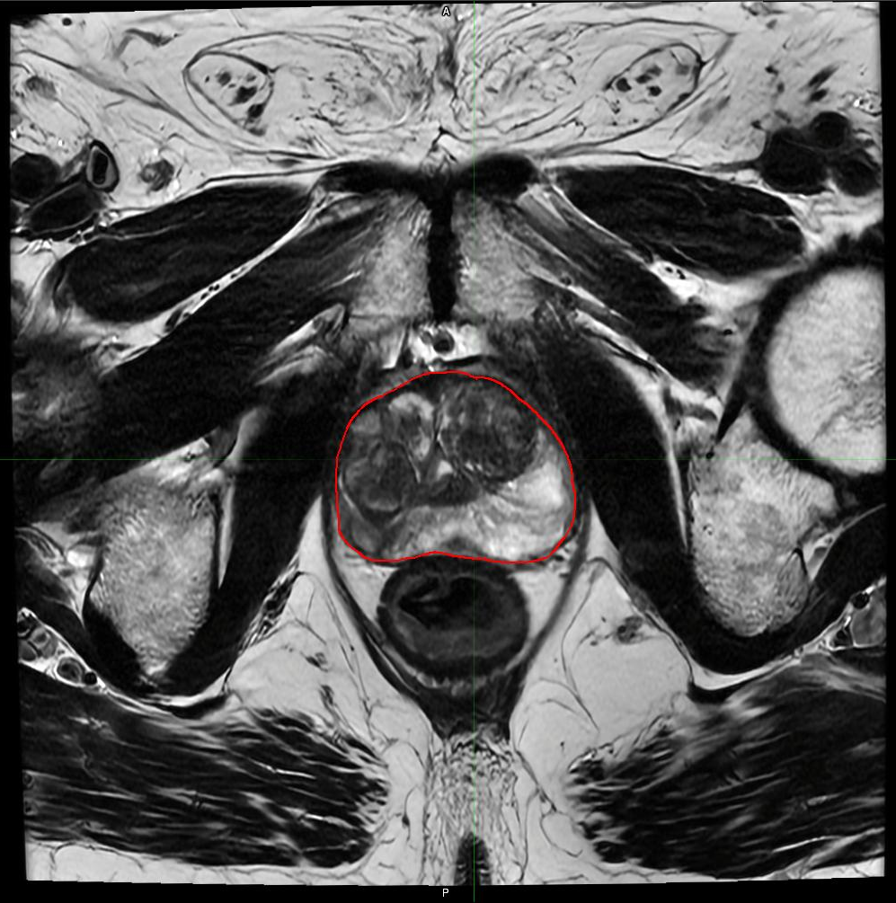
Prostate MRI Contouring Atlas – Prostate Case 1
Axial Slice 20
Song, et al. IJROBP 2025. PMID: 40154847
SeibertLab.com

Slide 22
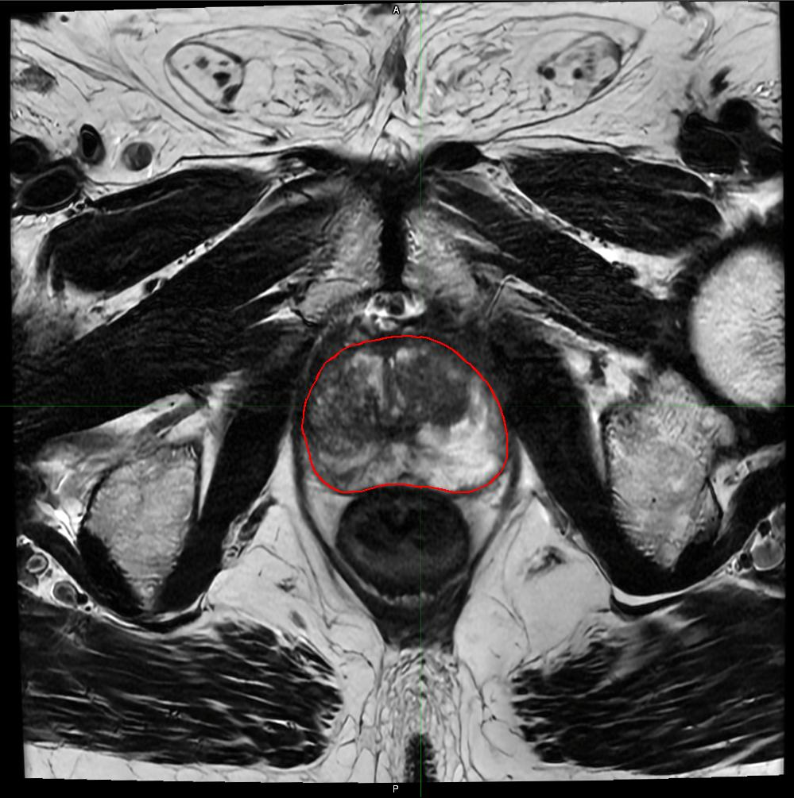
Prostate MRI Contouring Atlas – Prostate Case 1
Axial Slice 21
Song, et al. IJROBP 2025. PMID: 40154847
SeibertLab.com

Slide 23
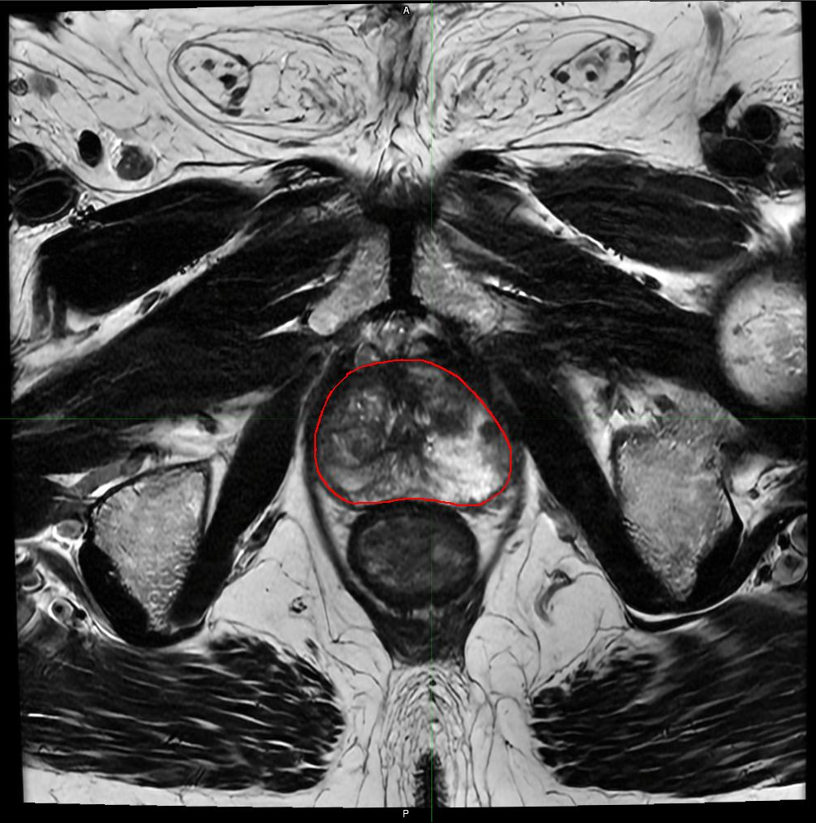
Prostate MRI Contouring Atlas – Prostate Case 1
Axial Slice 22
Song, et al. IJROBP 2025. PMID: 40154847
SeibertLab.com

Slide 24
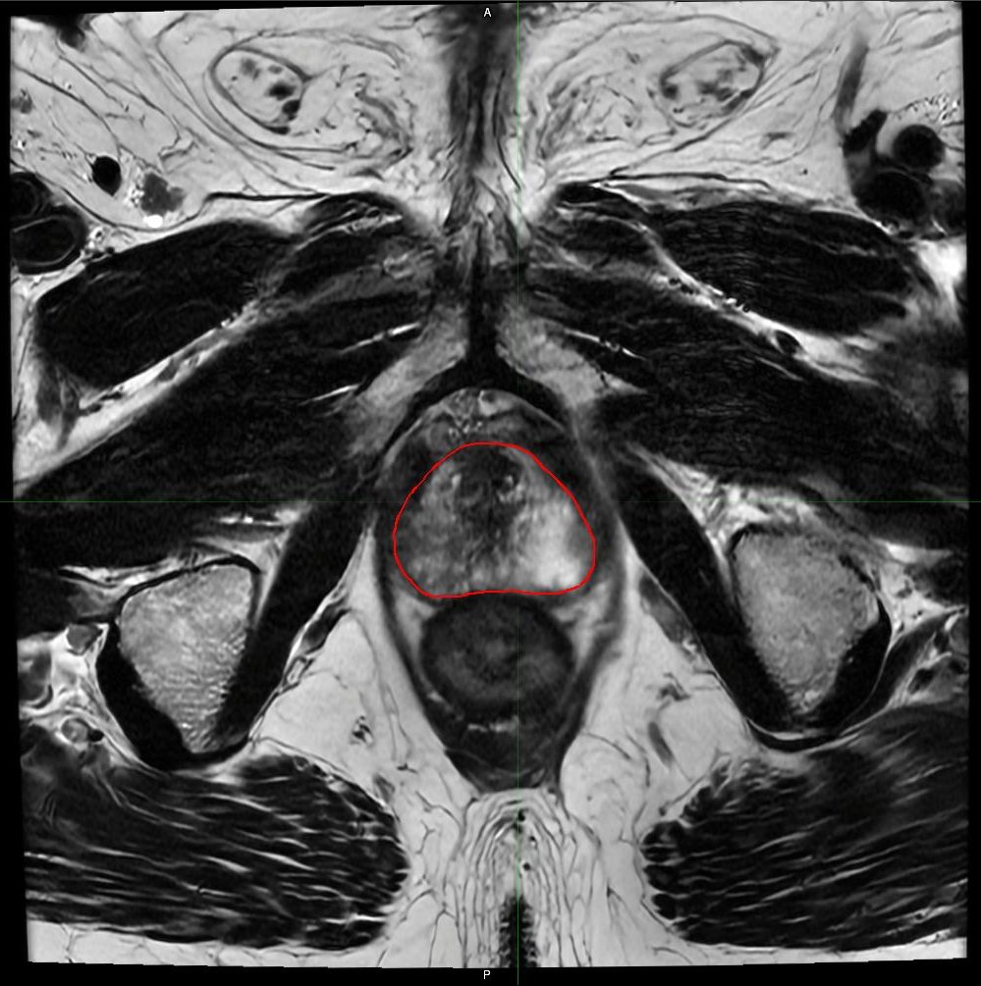
Prostate MRI Contouring Atlas – Prostate Case 1
Axial Slice 23
Song, et al. IJROBP 2025. PMID: 40154847
SeibertLab.com

Slide 25
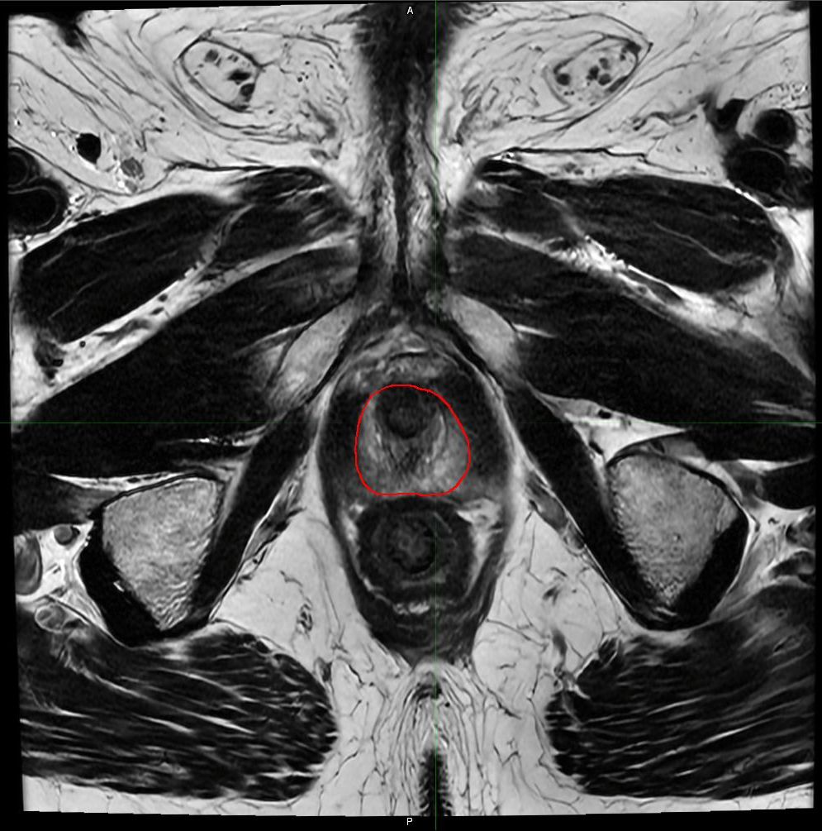
Prostate MRI Contouring Atlas – Prostate Case 1
Axial Slice 24
Song, et al. IJROBP 2025. PMID: 40154847
SeibertLab.com

Slide 26
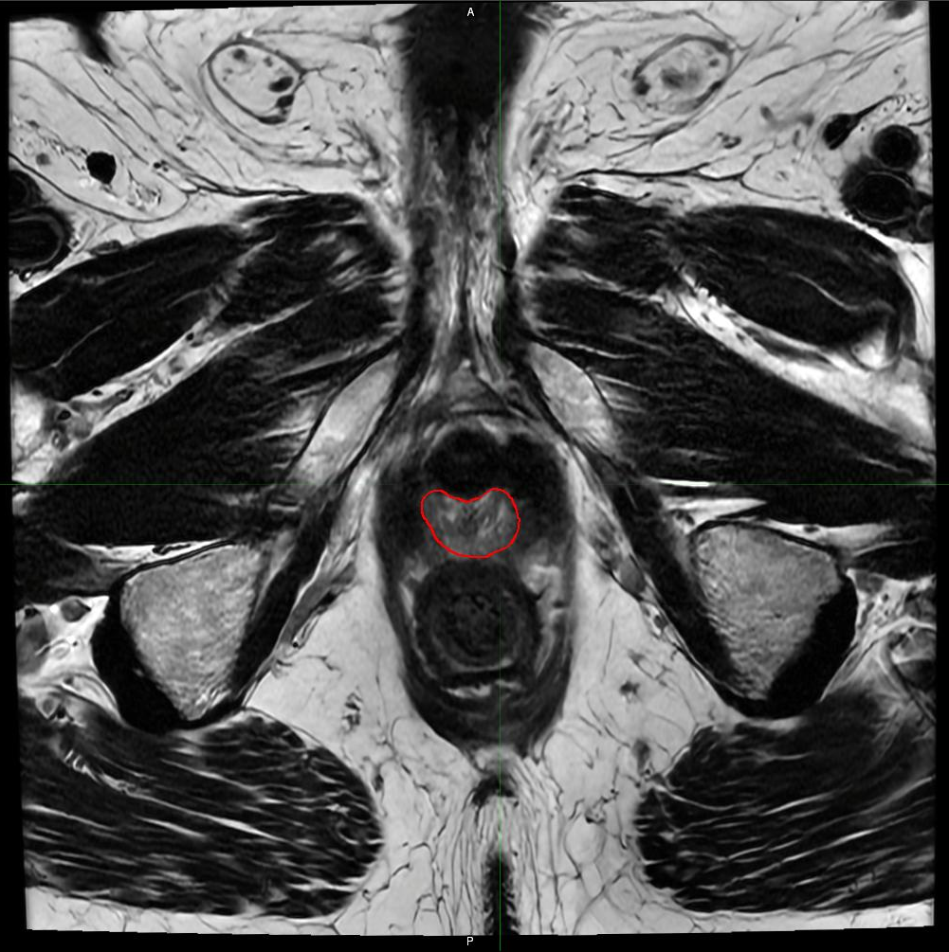
Prostate MRI Contouring Atlas – Prostate Case 1
Axial Slice 25
Song, et al. IJROBP 2025. PMID: 40154847
SeibertLab.com

Slide 27
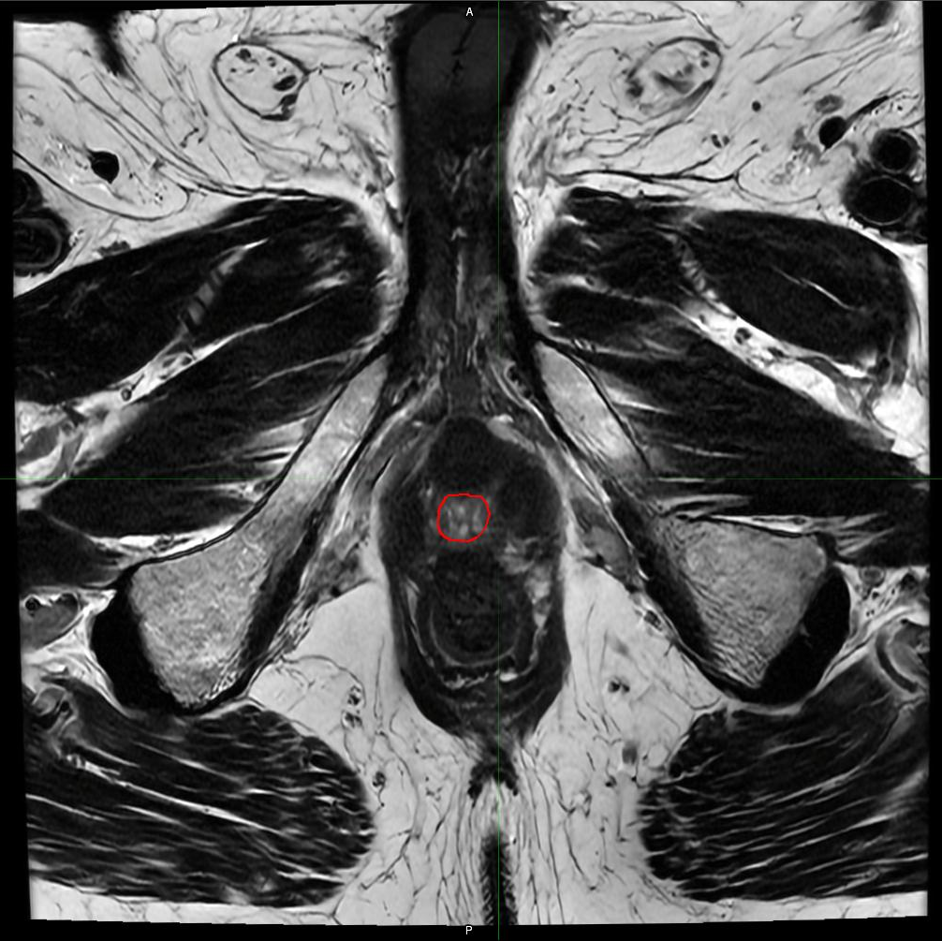
Prostate MRI Contouring Atlas – Prostate Case 1
Axial Slice 26
Song, et al. IJROBP 2025. PMID: 40154847
SeibertLab.com

Slide 28
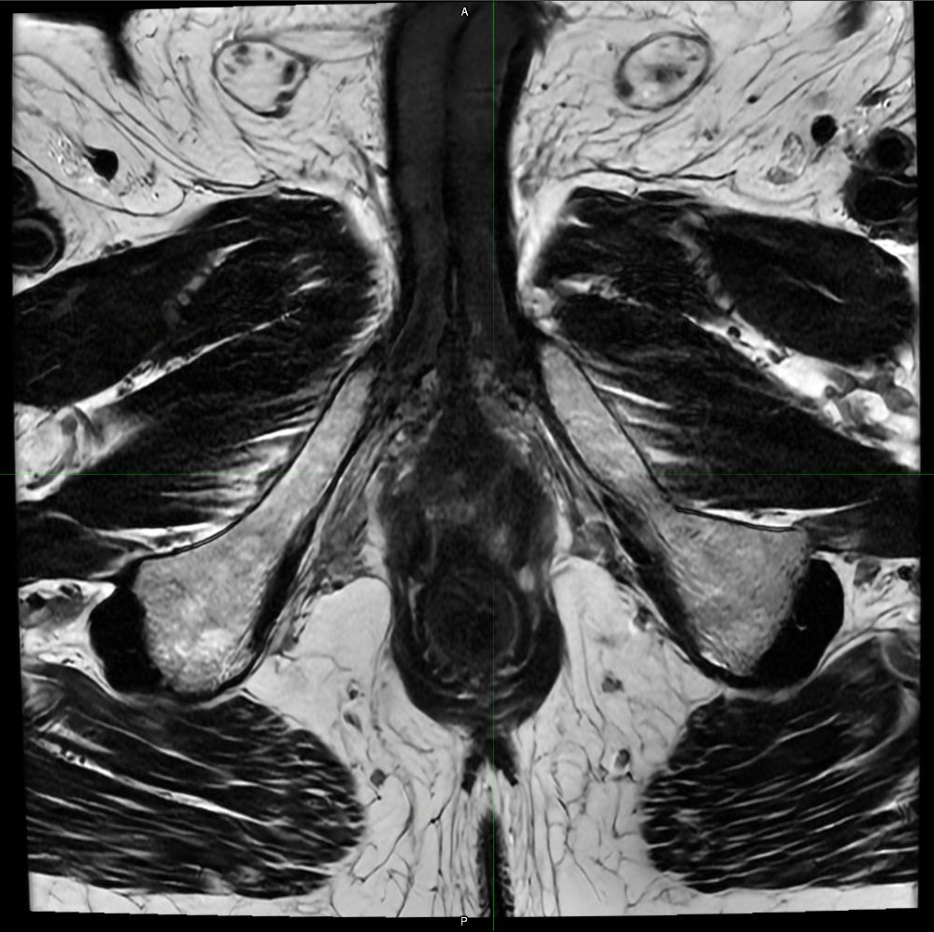
Prostate MRI Contouring Atlas – Prostate Case 1
Axial Slice 27
Song, et al. IJROBP 2025. PMID: 40154847
SeibertLab.com

Slide 29
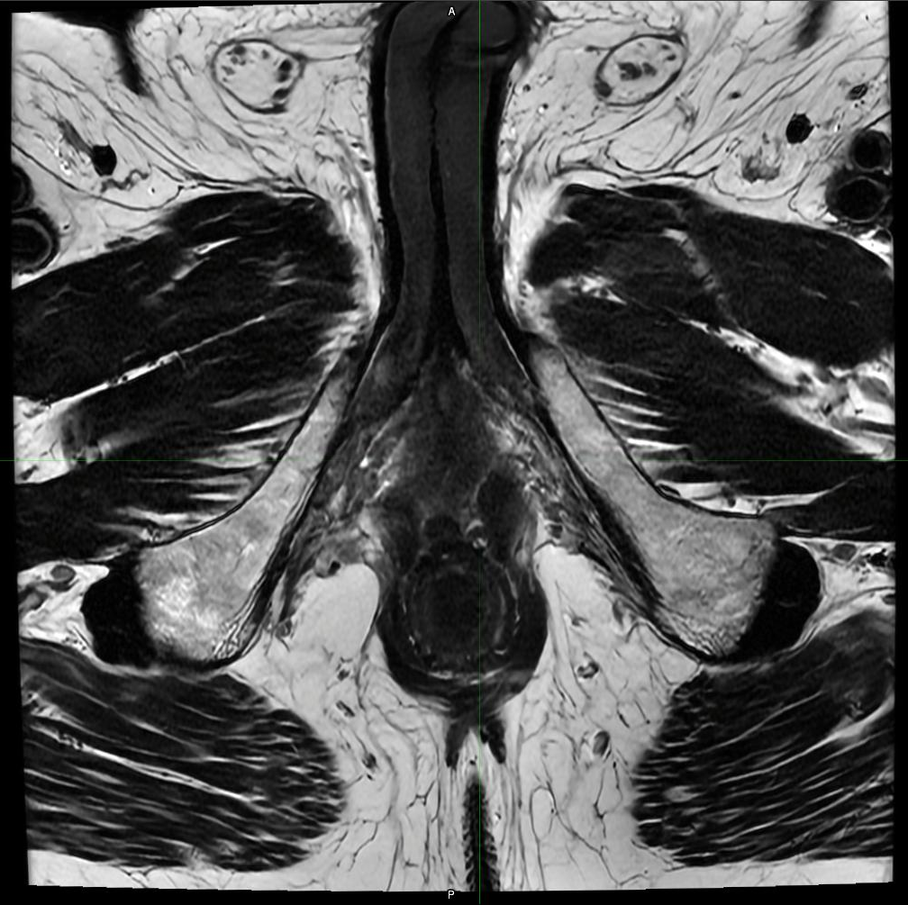
Prostate MRI Contouring Atlas – Prostate Case 1
Axial Slice 28
Song, et al. IJROBP 2025. PMID: 40154847
SeibertLab.com

Slide 30
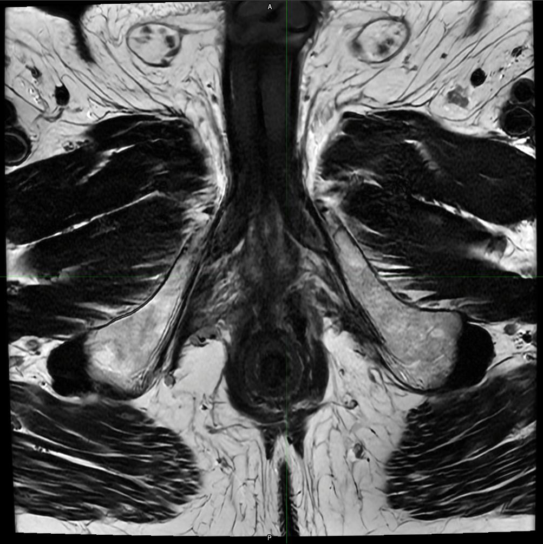
Prostate MRI Contouring Atlas – Prostate Case 1
Axial Slice 29
Song, et al. IJROBP 2025. PMID: 40154847
SeibertLab.com

Slide 31
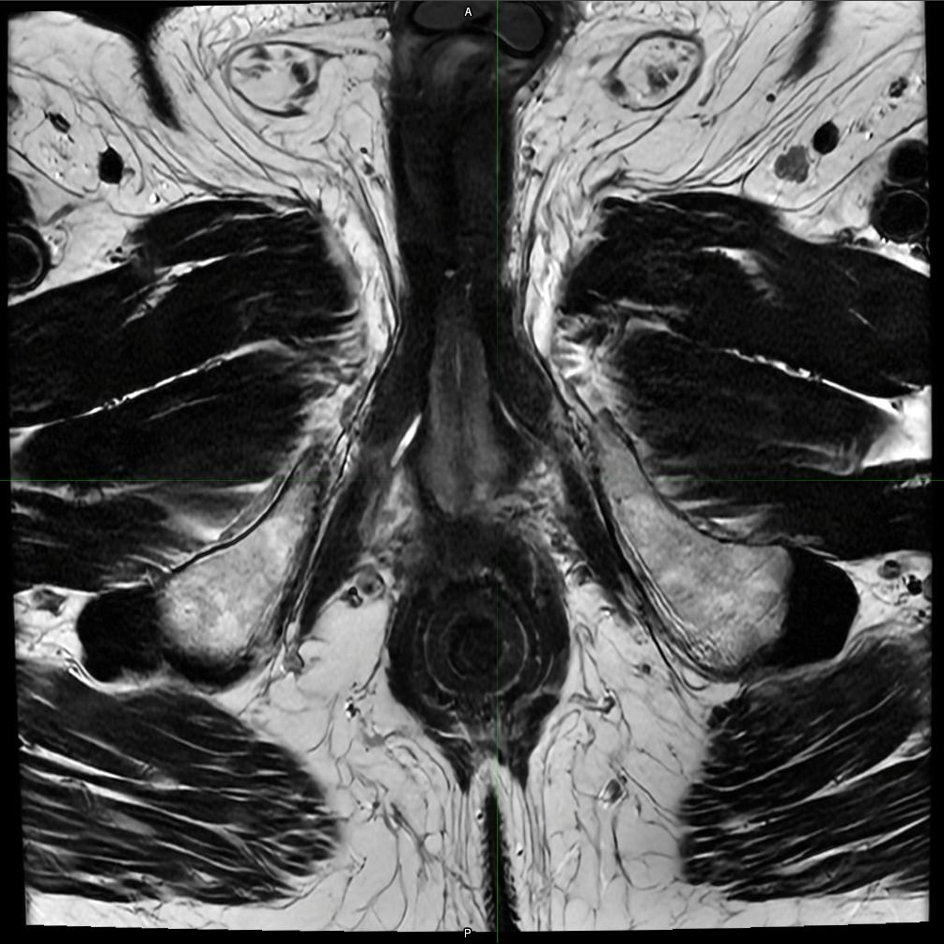
Prostate MRI Contouring Atlas – Prostate Case 1
Axial Slice 30
Song, et al. IJROBP 2025. PMID: 40154847
SeibertLab.com

Slide 32
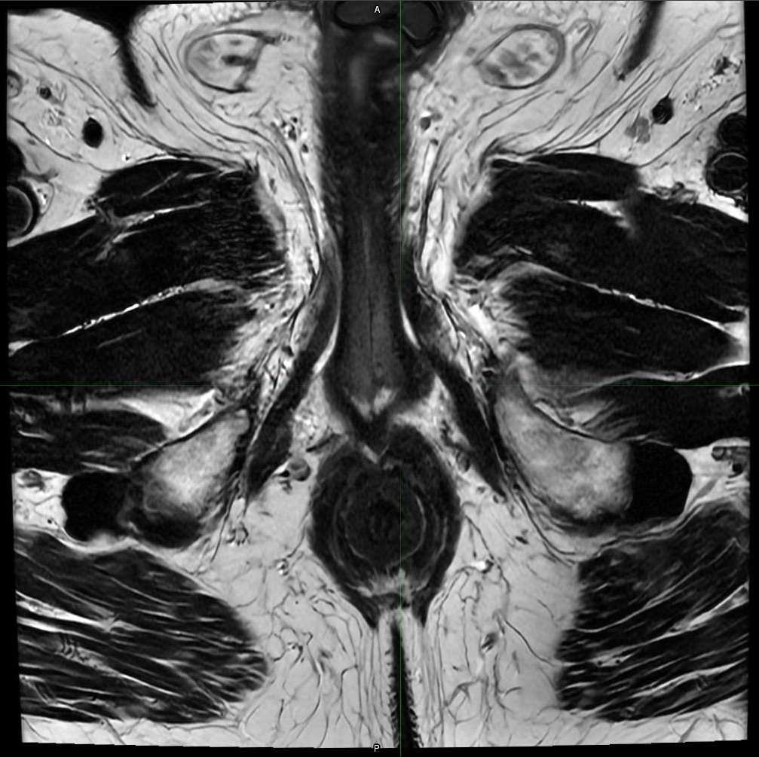
Prostate MRI Contouring Atlas – Prostate Case 1
Axial Slice 31
Song, et al. IJROBP 2025. PMID: 40154847
SeibertLab.com

Slide 33
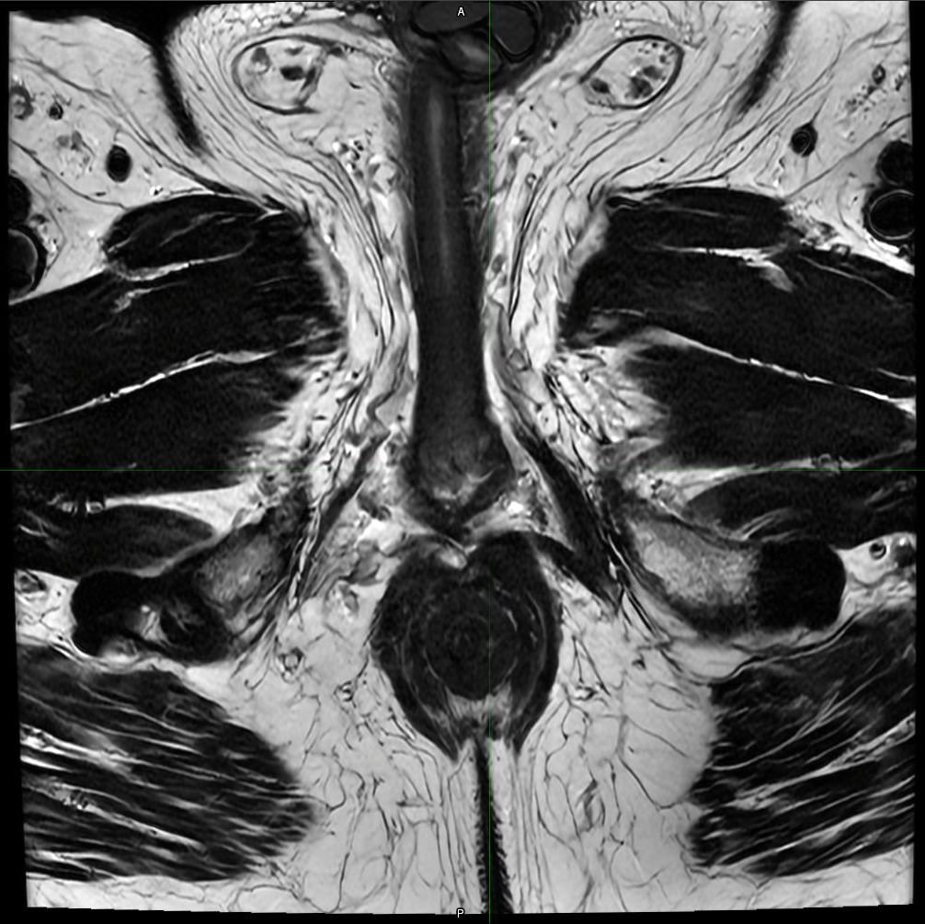
Prostate MRI Contouring Atlas – Prostate Case 1
Axial Slice 32
Song, et al. IJROBP 2025. PMID: 40154847
SeibertLab.com

Slide 34
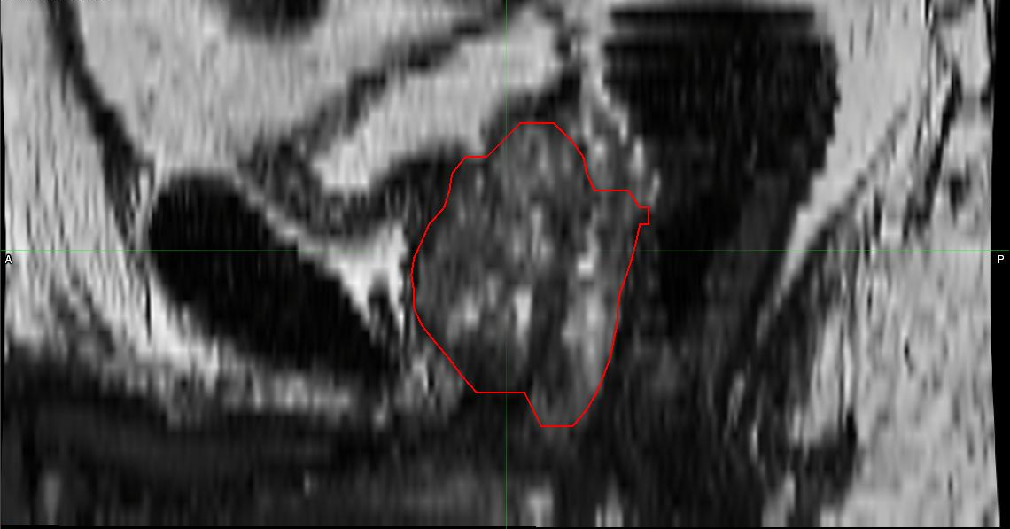
Prostate MRI Contouring Atlas – Prostate Case 1
Mid Sagittal
Song, et al. IJROBP 2025. PMID: 40154847
SeibertLab.com

Slide 35
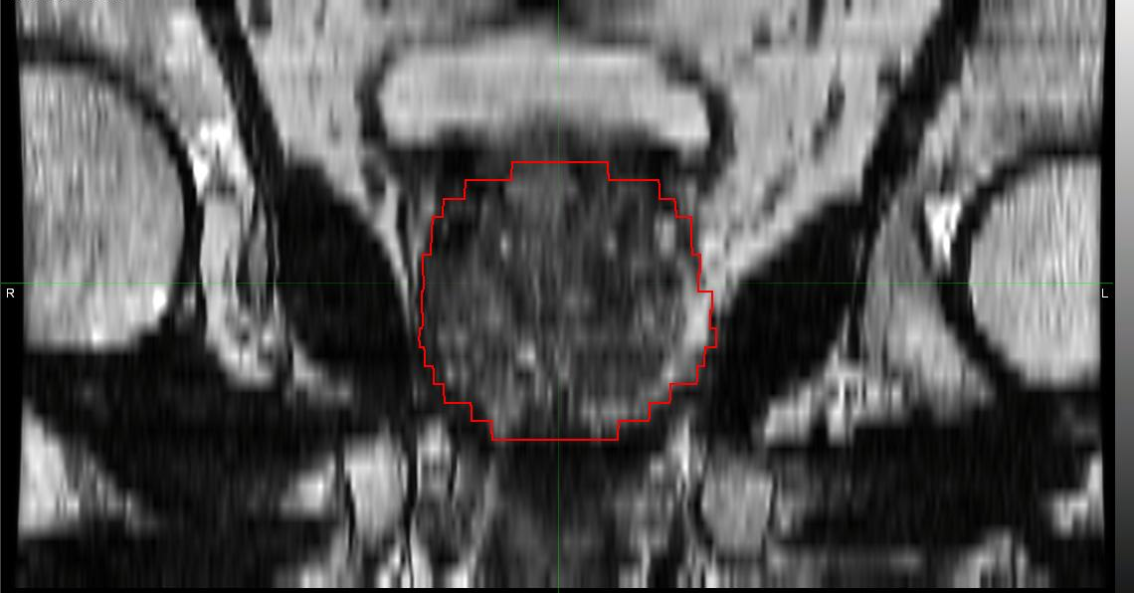
Prostate MRI Contouring Atlas – Prostate Case 1
Mid Coronal
Song, et al. IJROBP 2025. PMID: 40154847
SeibertLab.com

